Slide 1
Exhibitions for Beginners
Society of CA Archivists
Environmental Design Archives,
University of California Berkeley, wurster hall, Room 280
April 17, 2015
Nancy J. Arms Simon
Visual Resources Specialist / Library Fine Art specialist
Leonard Library at San Francisco State University

Slide 2
Agenda
9 – 10:30 Introduction
A bit about the speaker and what we’re doing today
A little bit about you, the workshop participant
Archives vs Museums
Exhibition Team Roles
10:30 – 10:45 Morning Break
10:45 – 12:30 The How-to Part
Start with an assessment
Key components of an exhibition
12:30 – 1:30 Lunch
Notes:
Hand out #1: Agenda and verso: a few resources that are really good, there are more books, these are my favorites.
Leftridge does workshops on the west coast with Western Museum Association, California Association of Museums.
What we’re doing and who I am
We want to know who you are and where you are at in your exhibition program
Discuss the differences between archives and museums
Get into Exhibition Team Roles as they are in museums
Break
The How – to Part
Assessments
Key exhibit components
Lunch

Slide 3
Agenda
1:30 – 2:30 Small Group Exercise, Part 1
Plan a mock exhibition, using assessment, roles and components
3:00 – 3:15 Afternoon Break
3:15 – 3:45 Small Group Exercise Part 2
Review your work and prepare to share
3:45 – 4:30 Share and evaluate mock exhibitions
Share and evaluate our exhibits
4:30 – 4:50 Discussion and Wrap up
4:50 – 5 Evaluation
Notes:
Afternoon will be spent creating small mock exhibitions, reviewing our work and sharing our work
We will adjust the timing depending on how people are doing and we’ll break at one point for a breather

Slide 4
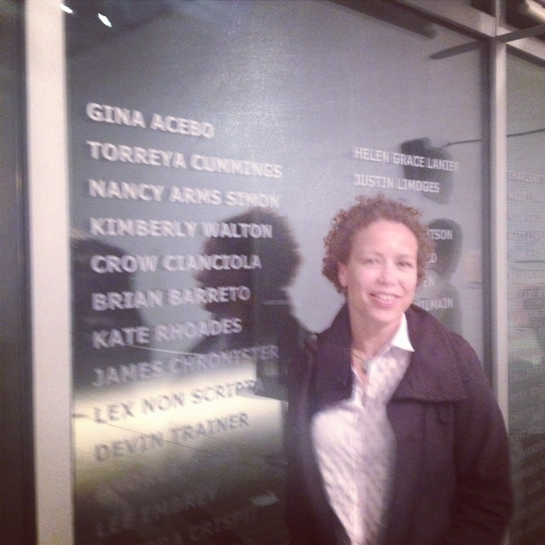
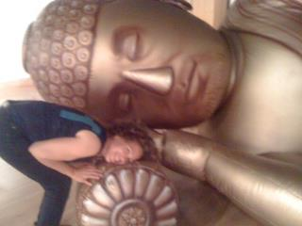
Introduction: Who am I and what do I do?
Notes:
Visual Resources Specialist
A collection manager, a registrar, an exhibit manager
A person who seems to have found a niche doing exhibits in libraries and archives
A person in a museum bubble -
So therefore…I’m going to show you some slides of what I’ve done
Using my experiences to wade into the waters of exhibitions and answer the question: why archivists do exhibits?

Slide 5
Labor Archives and Research Center SFSU Fine Art Department
Image Courtesy of: the Labor Archives and Research Center
Notes:
Most of these are not formal gallery spaces, they are spaces like yours
will illustrate the height and depth of the spaces I have to work with, and what kind of visibility they had
Archives are often a lot of papers, but every body gets in these objects maybe stuck in boxes along with the papers, maybe it’s a poster collection
#1 ----for Archives to do exhibits: You need to separate out these things, for the health of the objects and the collection depends on it, what are you going to do with them?
Example of the matches
In 2008 I started interning at the Labor Archives and Research Center.
Art Department – always empty at the beginning of the semester before the students have created artwork; prior RELATIONSHIP allowed me to call the person who had the key…
This is a walk through space
#2 ---for Archives to do exhibits: Because it’s an empty space – maybe someone says you have to fill it or you just can’t stand to see an empty display case

Slide 6
Labor Archives and Research Center (Winston Avenue)
Image Courtesy of: The Labor Archives and Research Center
Notes:
Still with the Labor Archives in our old space
2009 The 1934 General Strike. 75th Anniversary. Reading Room, four small cases.
Put together these artifacts and documents to highlight the collection and tell the story.
We had a brochure to tell about the specific objects in the cases.
People are staying in this room longer, but they’re not here to see the exhibit. Mostly looked at it when they were waiting for materials to be pulled
Person on staff considered himself an expert, was upset that I was asked to do this, but this isn’t about writing a book, it’s about using visuals to create a story.

Slide 7
Occupation! Economic Justice as a Civil Right in San Francisco, 1963 – 64 San Francisco History Center, San Francisco Public Library
Image courtesy of: The San Francisco Public Library Exhibitions Department
Notes:
2010 Thesis exhibit:
again, primarily a walk through space.
Documents drawn from the Labor Archives and Research Center, also pins and booklets.
San Francisco History Center at the SFPL had documents, and original newspaper photographs.
We included a loop of part of an oral interview by John Elrick, a history grad student.

Slide 8
Occupation! Economic Justice as a Civil Right in San Francisco, 1963 – 64 San Francisco History Center, San Francisco Public Library
Image courtesy of: The San Francisco Public Library Exhibitions Department
Notes:
Images by Phiz Mezey were the driving force behind the exhibit. We had them stand alone in a clean case, and used the photo morgue photos with the edit lines to distinguish
About 300 letters to the Mayor, John Shelley,
included positive and negative, put ugly language at the bottom, used pull out quotes to show what the main themes were, and more powerful statements.
It meant READING ALL THE LETTERS, this is the type of work that people often don’t understand goes into curation
Form response letter from the mayor was in the middle.
#3---- The best reason for Archives to do exhibitions: of course is to draw visually draw attention to a collection or an untold story.
Again, documents can be kind of boring, if you rope people in with objects that are visually or historically riveting, they will want to know more, and ideally go to your collections. Visually draw attention to your collections
EG: Recent experience of a fellow contacted me through linked in re: his teenager in England, studing U.S. Civil Rights Movement – knows it’s no longer on exhibit BUT IS INTERESTED IN LOOKING AT THE MATERIAL! Woot woot!!

Slide 9
Occupation! Economic Justice as a Civil Right in San Francisco, 1963 – 64 Rosenberg Library at City College of San Francisco
Images courtesy of: Katherine Connell
Notes:
City College of San Francisco asked us to put it up,
used the long cases on the left as a way to create a timeline.
Phiz Mezey’s photos were stand alone
Then these other cases were used for the map, the opening text, books relating to the subject.
Used scanned copies from the library, original material from Labor Archives.
Borrowed Phiz’s prints again.
The curation was already done, I had to re-format the ideas to fit the space.

Slide 10
Occupation! Economic Justice as a Civil Right in San Francisco, 1963 – 64 Leonard Library at San Francisco State University Museum Studies 730 Exhibit Design and Planning
Notes:
My thesis: The gift that kept on giving:
Fall 2012 the newly renovated library at SFSU had opened with this glorious gallery.
Catherine Powell from the Labor Archives wanted to have the exhibit shown at SFSU, since it had never been shown on campus.
At the same time, I was invited to teach a course on Exhibit Design and Planning through Museum Studies.
The students reworked the exhibit to focus on the nature of protest, ended with the Occupy Wall Street movement and asked questions about the effectiveness of protest to create change
We had a student put together a video with material from the Bay Area Television Archives.
Very sparse, you can see how we had to use a standing projection screen and a pedestal to hold the projector.
Cases were breaking when we started install. Never thought I should pull the plug on an exhibit quite like I thought it here. The cases had been designed and ordered by a company that had never done museum exhibition cases. They were more like department store cases: glass, meant to be set up once and never moved.
“the visitors do not know what you meant it to look like, they know what they see”

Slide 11
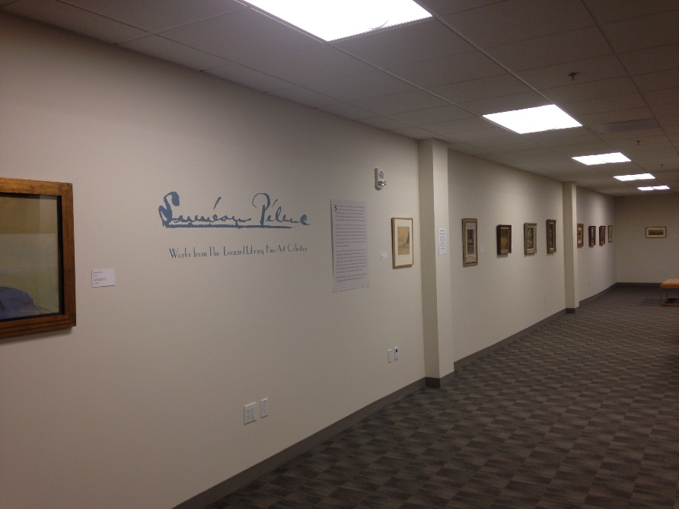
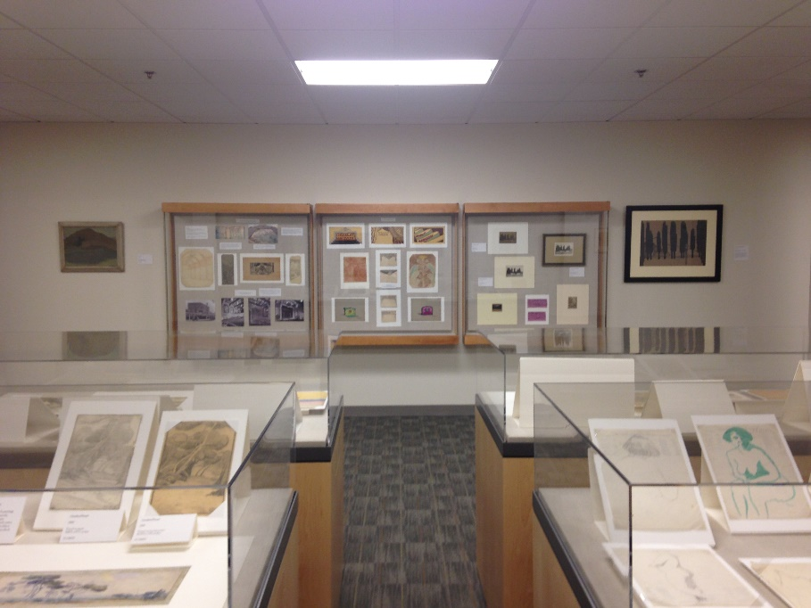
Siméon Pélenc: Works from the Leonard Library Fine Art Collection Leonard Library Special Collections Gallery
Notes:
Same gallery space,
now we’ve got good display cases,
doing vinyl pretty signature vinyl in the bottom left
The gallery looks full, the wall cases are in place,
The lighting is still bad….

Slide 12
What We’ll Be Doing Today
A crash-course in conceptualizing, creating, and evaluating exhibits.
Assessing available resources
Managing timelines and goals
Designing a compelling story and practical tips on how to tell it visually and textually
Basic design principles; and
Collections handling, care, and documentation.
The afternoon portion of the workshop is a small-group exercise in creating your own exhibit.
Notes:
I took the goals from the what you were promised when you signed up, but I’d like to shape it to what you need.
This is a beginning course.
Go through the goals
I work with archivists, but I’m not an archivist
This is based on what I know, what my experience is

Slide 13
A little bit about you, the workshop participant
Name and Title
What is your experience with exhibits?
Where do you stand right now with exhibits in your institution? Or why did you take the workshop?
What you’d like to get out of the workshop
Notes:
5 minutes afterwards to focus and figure out priorities

Slide 14
Archives vs Museums: Similarities and Differences
Courtesy of the Labor Archives and Research Center
Different approaches for collecting
Archives collect by the Collection, Museums collect by the object
Museums are generally exhibit driven
What is a document and what is an artifact?
U.S. Dept. of Labor Compliance Memorandum
Newspaper Guild Petition to Unionize
Notes:
Why do we start here?
I’m not an archivist,
We need to: Establish common language
You have different ways and reasons for collecting things – how you approach collecting affects how you approach handling objects in an exhibition
Museum collection exhibits approach things item by item, archive is by collection
When organizing an exhibit you have to change how you think about collections and the objects
Documents tend to be boring to look at. Look at
the document on the left ----U.S. Department of Labor Compliance Memorandum (bo-ring!)
the document on the right is a petition to unionize, it’s a secret so it’s been folded up and carried in back pockets and secretly passed between people.
The tape becomes part of the object’s story.
People do not stand at a display case and read documents.
When you’re exhibiting documents, think about what is an compelling object
Think about what is a compelling pull quote.
Think about what the audience needs to know about the document PLUS how it fits into the story you’re telling.
What is a document and what is an artifact?

Slide 15
Museum Exhibits Organization (Hierarchy)
Director
Curator
Exhibitions Manager
Head Registrar
Head of Development
Facilities Manager
Janitorial
Head of Education / Outreach
Volunteers
Chief Preparator
Collections Manager
Registrar
Registrar
Preparator
Preparator
Interns
Visitor Services
Notes:
We’re going to look at similarities in the kinds of work you do
Museum Exhibitions Organizational Chart
Director has several underlings
Including the Collections Manager, Head of Education, Facilities Manager, Head of Development, also Conservation
the Curator is the head of the Exhibitions Department

Slide 16
Museum Exhibits Organization (Hierarchy)
Curator
Exhibitions Manager
Head Registrar
Chief Preparator
Registrar
Registrar
Preparator
Preparator
Graphics
Notes:
So let’s pull him out along with the Exhibition Staff
Typically the Curator manages the Exhibitions Staff, if a museum has several Curators (curator of photography, curator of sculpture, then they have to share the exhibitions staff
Sometimes the Collection Manager oversees the Registrars

Slide 17
Exhibition Team Roles
Exhibits
Exhibition Manager
Education
Curation
Preparators
Registration
Collections Management
Volunteers
Graphic Design and Collateral
Development
Facilities
Notes:
But in smaller institutions, you really have to throw away the hierarchy and establish who is going to take on what roles, depending on your institutions protocol.
the truth is, Exhibits are a major undertaking, even “small” exhibits, even “quick” exhibits
example of building a one bedroom house or a fourteen bedroom house
And it involves your entire institution, and it’s not a hierarchical model, and things go back and forth and get passes around
As I discuss these roles:
You may be working with someone from museums, and by their job title you will have a better understanding of their skills
and you need to see where your tasks and possibly untapped skills overlap with these museum roles, because you will have to find the skills in your team to handle these tasks
And in archives, you don’t have a designated exhibition team so everybody has to pick a couple hats…

Slide 18
Too many hats = insanity
Notes:
Warning: wearing too many hats, it can lead to insanity! So it’s important to , assess whether your institution is equipped to take on exhibitions
And we’ll talk about how to assess what you have in a few minutes

Slide 19
Exhibition Manager
Exhibits
Exhibition Manager
Education
Curation
Preparators
Registration
Collections Management
Volunteers
Graphic Design and Collateral
Development
Facilities
Manages the exhibition schedule
Needs to understand each role and how the roles work together
Manages outreach for loans, permissions
Notes:
These descriptions are in no particular order because all the parts are working together
You have parallels to some of these in archives and in your institution, so I’ll go through the duties and you can think about whether you have this type of responsibility in your institution, and if you do, who plays that role.
Read through

Slide 20
Education
Exhibits
Exhibition Manager
Education
Curation
Preparators
Registration
Collections Management
Volunteers
Graphic Design and Collateral
Development
Facilities
Ideally works with Curator and Exhibition staff from the beginning
Creates programs and activities
Notes:
Read
Promotes outreach to communities to make them aware of what’s happening in your institution
Often they are the face that interacts with the public, they give tours, they handle outreach to schools and work with Development
The develop ways for different types of learners to engage with your exhibit,
They know your public in an intimate way

Slide 21
Curator
Exhibits
Exhibition Manager
Education
Curation
Preparators
Registration
Collections Management
Volunteers
Graphic Design and Collateral
Development
Facilities
Knows the collection
Researches the objects and edits content
Develops exhibit themes
Writes didactic (and label text)
Notes:
Larger institutions have an Exhibition Designer, many places rely on the Curator, or the Exhibition Team as a group
Design theory is not an overnight thing, it’s a skill.
Find the person on your staff who is artistic, who has good a good sense of design (Tanya has better design sense than me)
You can do a “quick exhibit” that is just vinyl and wall panels, but that is not going to utilize your objects or collections, and it’s still going to take time, and there will be more pressure for good design to make it riveting because there will not be the intangible magnetism of the object.

Slide 22
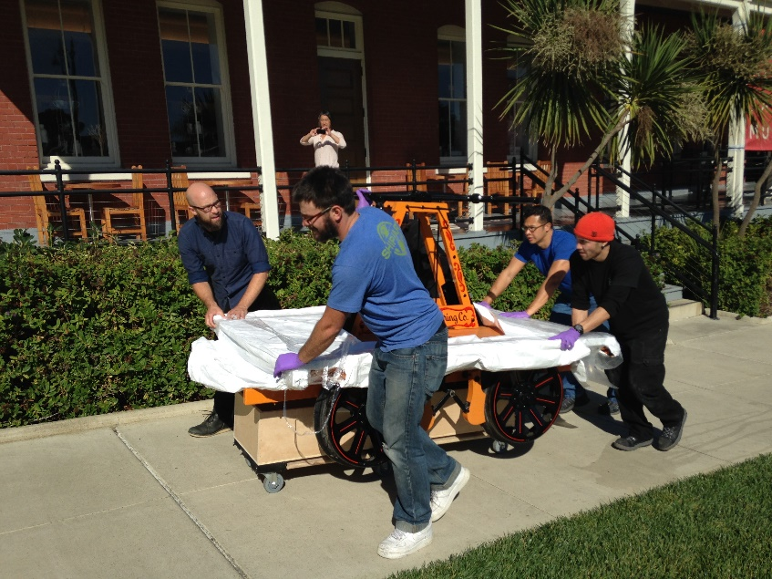
Preparators / Art Handler
Exhibits
Exhibition Manager
Education
Curation
Preparators
Registration
Collections Management
Volunteers
Graphic Design and Collateral
Development
Facilities
Handles the physical movement and installation of objects
Notes:
This is a photo of a hand pushed train cart, like the kind you see in the cartoons. Couldn’t be rolled in, but it weighed a ton, so this box was created to ride it on, stay clean and unblemished
I say this because:
Try to describe the work that goes into art handling
These people Understand the materials behind the object and how to handle it,
Works with curators and artists to realize exhibit ideals EG: (I’d love to have someone step on a pad, and the speech starts…) (I’d like this marionette to look like it’s suspended from real hands…)
Works with Registration to move objects safely
Builds mounts, frames pictures
A word about employing a preparator: get one if no one has these things in their toolbox, pay them for their skills,
Ask yourself, can you cut a matboard perfectly straight with a utility knife and a straight edge?

Slide 23
Registrar and Collections Manager
Exhibits
Exhibition Manager
Education
Curation
Preparators
Registration
Collections Management
Volunteers
Graphic Design and Collateral
Development
Facilities
Documents and Records
Maintains records of movement, condition, loans
Transportation Security Administration
Handles the movement database
Recommends objects for conservation/oversees
Advises and works with Curator
Notes:
Registrar: documents and records; maintains exhibit spreadsheets, receives objects, maintains records of movement, condition and loans, since 9/11 well-trained Registrars know the requirements of the TSA
How object is used when INVENTORY CONTROL has to happen
Condition Reports
HANDOUT #2 Sample condition report, (I should always fill these out but I don’t because I’m a one woman operation trying to save time where I can), when I do it’s because
the object is new to the collection and I want to establish a baseline condition
the object belongs to someone else
there is some blaringly obvious damage
I’m drastically making a change to it, re-framing, re-attaching a piece, etc.
of course, If I do it harm, which I never ever do
Collections Manager: Handles the movement database, recommends objects for conservation and oversees conservation treatment, advises and works with the curator on what’s available in the collection
Both of these people generally can do some of the skills of the other person, depends on how the institution hires
Both of them can act as couriers

Slide 24
Volunteers
Exhibits
Exhibition Manager
Education
Curation
Preparators
Registration
Collections Management
Volunteers
Graphic Design and Collateral
Development
Facilities
Often part of Visitor Services
Frequently works with Education as a docent
Notes:
These people are on the front lines of working with the public and they are the face of your institution – keep them informed and keep them happy
Do not confuse interns with volunteers

Slide 25
Graphic Design and Collateral
Exhibits
Exhibition Manager
Education
Curation
Preparators
Registration
Collections Management
Volunteers
Graphic Design and Collateral
Development
Facilities
Designs and creates
Wall vinyl
Didactic panels
Promotional material
Labels
Notes:
Again, design is a skill.
It’s something you can learn, but it doesn’t happen overnight.

Slide 26
Development
Exhibits
Exhibition Manager
Education
Curation
Preparators
Registration
Collections Management
Volunteers
Graphic Design and Collateral
Development
Facilities
Generates revenue
Promotes the exhibits
Notes:
If you get their buy in to what you’re doing they can be one of your greatest assets

Slide 27
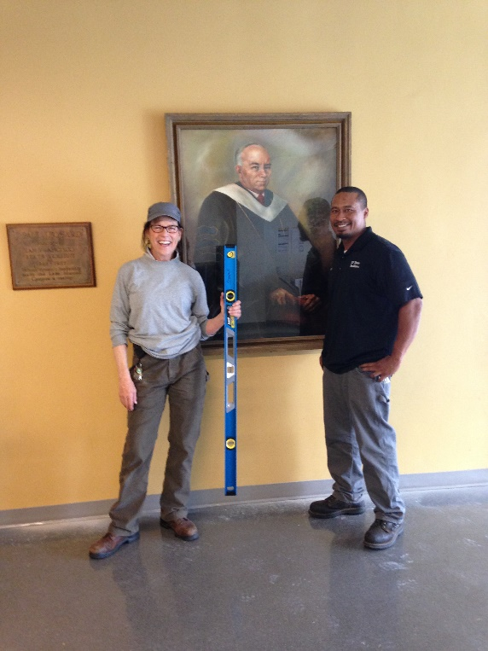
Facilities
Exhibits
Exhibition Manager
Education
Curation
Preparators
Registration
Collections Management
Volunteers
Graphic Design and Collateral
Development
Facilities
They make sure it happens without breaking any rules
They unlock the doors, fix the leaks and clean up the messes
Notes:
They schedule your loading zone
They have the tools, the palette jacks, the dollies, the hand carts

Slide 28
Morning Break

Slide 29
Start with an Assessment
Assess what you have
Notes:
we will go over the components of an exhibit like Interpretive writing, installation, scheduling, but
First you have to assesss your situation
What I had in mind was that “you’ve been told to fill a space” and you have to figure out what it’s going to take to do that.
HANDOUT #3 Assessment Questionnaire
Take this with you

Slide 30
Exhibit Scheduling Key Components of an Exhibition
One year minimum
Consider your collection, decide what material you want to show
Create your theme and storyline / survey what you have to draw from
Work with Education on Audience targets and outreach
Determine your viewing hours
Consider your vendor options for food, beverages, entertainment and programs (relate everything to your theme)
Create an object list –
Pre-Install Exhibit preparation
Work on laons, concepts, graphic fonts, signature images, titles, didactics
Labels: creation and mounting
Mounting objects (send out for mounts?) and framing
Seek permission for quotes, images, etc.
Work on loans, concepts, graphics
Write your press release (3 + months in advance)
Notes:
HANDOUT #4 Exhibition Scheduling
DEE SAID, “THE SCHEDULE IS THE TOOL”
The way you track the components of an exhibit is through your schedule.
We’ll look at each component but the schedule is the “touchstone document”
One year minimum and ideally plan out the next three exhibits
Opening reception – take into account your community’s schedule: University: exam schedule, campus holidays; SFPL thinks about gay pride and Giants winning the World Series, Bay Area Television Archives doing and exhibit about a predominantly African-American neighborhood in SF: Juneteeth; United Farm Workers exhibit coincided with Cesar Chavez Day
Pick a date about a year in advance, then map out each item estimating how long it will take you, fiddle with it, get input from your group, what else is on your schedule? The British guy had never heard of Juneteenth….etc.

Slide 31
Exhibit Scheduling Key Components of an Exhibition
One year minimum
Installation: 2 – 3 weeks for a small (one gallery) space
Soft opening launches your evaluation period (one – two weeks before exhibit)
Evaluation: one – two week(s)
Opening Reception – including Clean up
Documentation
Take down and gallery turn over
Installation of next exhibit
Notes:
This is the rest of the exhibit schedule, we’ll go over each part

Slide 32
Create your theme(s) and storyline
A topic is not a theme
A theme has a storyline
Example:
topic: Conceptual Art
theme: Many of the founding artists of Conceptual Art lived in the Bay Area in the 1970s
subtheme: Conceptual Art thrives in the Bay Area to this day
Themes and telling a story with objects is not the same as writing a book
Create a takeaway message
Notes:
Keep notes on ideas as they occur
Consider your collection -
How do you create a story line when you’re missing objects?
While you’re planning your theme and storyline, you are simultaneously thinking about design and layout
Do you have the skills to do this? Do you need to work with an exhibit designer?
Work with the person on your team with good design sense – (this is rarely the person who TELLS you they have great design sense)
Get a sample from your audience (for us it’s the students I work with)
Like writing a book your title will often come when you’re ¾ of the way through the planning.
Occupation! Was about job equality and the early sit – in demonstrations. So it had the meaning of Occupation as in the work you do, and also occupying space.

Slide 33
Preliminary Planning
Work with Education on Audience Targets
Determine your viewing hours
Book vendors for opening reception food, beverage, entertainment and programs
Create your event schedule
Contact Facilities about janitorial, set up and take down of chairs, AV equipment, etc.
Notes:
LOOK AT THE HANDOUT WHEN YOU TOUCH ON THESE POINTS
Work with Education on Audience Targets - This should inform how you think about your exhibit design
Determine your viewing hours – think about security, docents, gallery sitters

Slide 34
Create and (try to) finalize your object list
Begin 9 months before opening date
work with preparator and/or exhibit manager to determine special mounting needs
Make a spreadsheet
Exhibit ID Number | Institution ID Number | Accession Number | Description | Needs Framing? | Needs Mounting? | Artist | Title | Date | Medium / Material | Dimensions H x W x D | Condition Notes | Home Location | Exhibit Location | Accessories / Handling Requirements | Thumbnail Image
Notes:
HANDOUT #5 Object List Columns
Exhibit ID Number
Institution ID Number
Accession Number
Description
Needs Framing
Needs Mounting
Artist
Title
Date
Medium/Material
Dimensions
Condition Notes
Home Location
Exhibit Location
Accessories/ Handling Requirements
Thumbnail image
Explain each, but what matters is that it makes sense to you

Slide 35
Pre-install exhibit preparation
Work on supplemental loans
Work on concepts, graphics: oversized graphics, vinyl, blow up images
Work on Text
Get objects mounted
See permission for quotes, images, adapting objects for exhibit
Schedule facilities and Audio Visual technologies and deliveries, janitorial
Contact Development

Slide 36
Pre-install exhibit preparation
Interpretive Writing
Golden Rule:
KEEP IT SHORT
Interpretive Writing is its own genre
Minimum 18 point font
Your audience does not need to read everything that you know
Do not start labels with “This…”
YOUR audience
5 measureable functions of interpretive writing by Leftridge
To justify text or not
Notes:
Keep it short: establish a formula that limits word count and use it. This doesn’t mean over-simplifying, means find correct word and syntax to have the best impact
Label Writing is its own genre, it is taking the tangible and making it emotional,
Like good design it is a skill that takes practice and development. Do the best you can and try to improve each time.
Minimum 18 point font
Your audience does not need to read everything that you know: focus on what the reader wants to read, not on what you want them to know
Do not start labels with “This…” unless you are trying to distinguish this cup from all the other cups
(Spanish example of YO pienso, (I think) or YO conduzco…(I drive my mother to the airport)
This often happens when you’re not looking at the object when you write the label (sitting at your desk)
YOUR audience! Think about who your audience is and who you would like to see coming through your doors.
To justify text or not: I think creating a square block of text makes it harder to read on a wall. Fine in a magazine or newspaper because you are holding it closer and the purpose is different
Don’t overuse quotes
Address the whole, strive for message unity

Slide 37
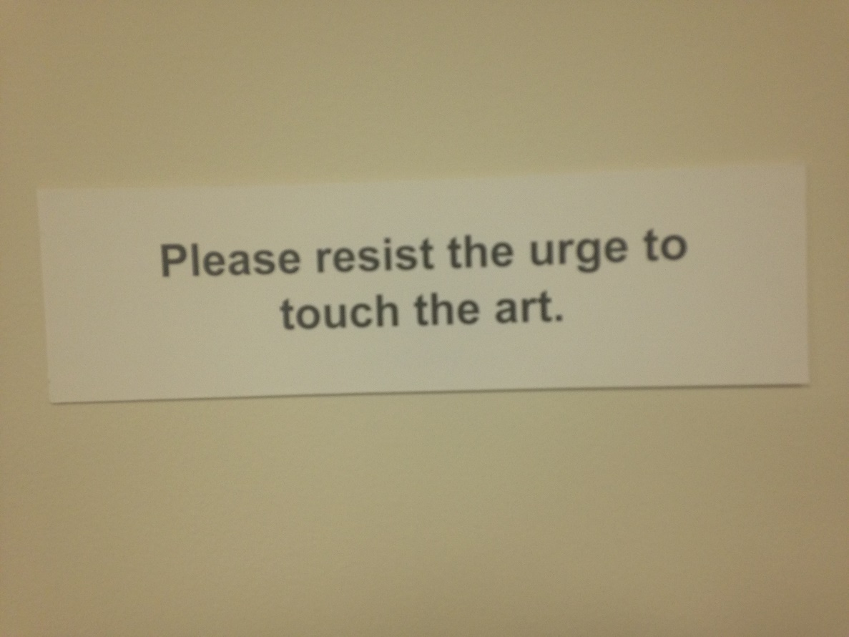
Interpretive Writing: Don’t say “Don’t”
Notes:
Avoid telling people what not to do.
Give them replacement behavior
Example from Dual Views of luscious C-prints mounted on aluminum

Slide 38
Exhibit Label Template
Creator
Title / Object Name
year
Medium
Measurements in decimal inches n (H x W x D)
Blurb always includes how they relate to SF State.
J. Paul Leonard Library Fine Art Collection
Donated by Danell S. Zeavin (B.A. Art, 1963)
Notes:
This is a basic format for what I use around the library
Within an exhibit you don’t have to have all this information

Slide 39
Exhibit Preparation
Mounting and Framing
Specialized mounts
Procuring Tools
Consider Security
*****Eek: you should already be laying out the basics for your next exhibit by this time.
Notes:
Mounting and Framing – make sure you have a supply of whatever you’re going to use for consistency,
The focus should be on the object, not on the mount
Mylar sleeves have terrible glare under most lights
Pass around Example of matboard easel
Ordering Specialized mounts
Gathering necessary Tools
Security (in general and for specific items)

Slide 40
Exhibit Preparation
A word about gratitude
Notes:
Be thankful, start a list when you start planning the exhibit and write down every name of someone who helps you along the way
Make sure you spell their name exactly as they like to see it in print
Thank people who are doing their job but went above and beyond when you really needed it
Thank your partner (for making dinner when you had to work until 11 pm that night)
Don’t thank people without cause, but don’t hesitate to thank someone who really stepped up.

Slide 41
Tools
Cotton gloves / Nitrile Gloves
Blue Tape
Large and small measuring tapes
Fabric or paper measuring tapes
Hammer
Screwdriver
Utility knife, exacto knife, BLADES, straight edge, memory board
Hanging hardware (Ziabicki)
Two foot level
“Torpedo Level”
Pencils
Sharpies
White erasers
Linen hinging tape
Double stick tape
Adhesive mounting board
Adhesive photo corners
Mylar stripping
Museum Wax
Caution Signs
Notes:
Hold up tools to show them what they look like – leave in the back of the room
For objects Nitrile can be good, doesn’t slip
I like nitrile better than latex, but latex gets a tighter fit
Cotton is still good for many things and easier to wear a long time
Always wear gloves when you are handling objects. Always. It doesn’t matter if you just washed your hands. Always means always.
Hammer – trust you know what one looks like
I have a photo of memory / self-healing board on next slide
Adhesive Mounting Board is for labels
Adhesive photo corners – example
Mylar stripping example

Slide 42
Tools
Security hardware
Notes:
Plastic coated metal wire
Crimps
Wire cutter and crimper
Utility knife and memory board,
screws, anchors, washers
Drill, drillbit and screwdriver bit
Show example of how security wire works
Also use book security strips inside frames, could probably use them on other things

Slide 43
Installation: 2-3 weeks before opening
Notes:
Example: Lusty Lady:
Q: What was most important in this industry zine?
A: The article inside written by the person from San Francisco discussing the struggle to organize.
Pull out text used to cover the questionable language. Show the nifty graphic.

Slide 44
Soft opening and evaluation period
One to two weeks before opening reception
A period of adjustment
Notes:
Evaluation can mean whatever you have time for.
Count numbers coming in, where they go, ask them a few pre-written questions, have gallery attendants record comments or numbers
Make sure the video monitor loop doesn’t stop, etc.
Make sure the wall labels don’t peel off when the temperature changes over the course of a few days.

Slide 45
Opening Reception
Pick up food, beverages, meet delivery vendors
Handling honorary guests, elderly, disabled
Set up chairs, AV
Restocking and cleaning during the event
Take down and clean up
Notes:
How is this going to get done?

Slide 46
Take down and gallery turn over
Last about two to three weeks after exhibit closes:
Removal of objects
Spackle, paint
Return equipment
Install of your next exhibit begins immediately after gallery turnover

Slide 47
Lunch

Slide 48
Small – Group Exercise, Part 1
Plan a mock exhibition, using assessment, roles and components

Slide 49
Plan Your Exhibit
Determine who will play which roles
Decide on an exhibit theme
Create an object list with descriptions, 2 -3 condition reports, home location, dimensions and exhibit placement as needed
Create a map with room dimensions, fixtures, and location of displays, outline how objects will be displayed
Number your display areas, walls, cases
Create two wall labels
Create an first draft of your introductory text
Plan an exhibition schedule
Notes:
Put some of this stuff into action
Build an exhibit or at least an exhibit plan
What do you want to
Review the roles
Summarize
Good Instructions
If you came with other members from your organization, get together and think about who will most likely take on which roles.
Use your own object lists or scenarios.
Make it useful to you
Hand out maps, map specifications, and a scenario

Slide 50
Afternoon Break

Slide 51
Small Group Exercise, Part 2
Review your work and prepare to share

Slide 52
Share and evaluate mock exhibitions

Slide 53
Discussion and Wrap Up
What did you take away?

Slide 54
Thank you!
Notes:
Thank Dee Kramer and Emily Vigor!
Thank the workshop participants!!

